Slide 1


SM
8/15/2024

Slide 2

Outline
Executive Summary
Introduction
Methodology
Results
Conclusion
Appendix

Slide 3
Executive Summary
Summary of methodologies
Data collection and wrangling.
Data was collected on the Falcon 9 first-stage landings Using a RESTful API and web scraping. We converted the data into a dataframe and then performed some data wrangling.
Exploratory data analysis and data visualization
EDA was used to determine which variables are most influential and a dashboard was built to analyze launch records interactively with Plotly Dash. An interactive map was created to analyze the launch site proximity with Folium.
Machine Learning models and predictions
Summary of all results
Variables that help to predict the landing:
Booster Version, Payload Mass, Orbit, Launch Site, Outcome, Flights, Grid Fins, Reused, Legs, Landing Pad, Block, Reused Count, Serial, Longitude, Latitude.
Machine learning models resutls:
Method | Score | Accuracy
logreg_cv | 0.944444 | 0.822222
svm_cv | 0.944444 | 0.822222
tree_cv | 0.833333 | 0.877778
knn_cv | 0.944444 | 0.84444

Slide 4
Introduction
Project background and context SpaceX promotes its Falcon 9 rocket launches on its website, with a price tag of 62 million dollars, while other providers charge more than 165 million dollars per launch. A significant portion of the cost savings is due to SpaceX's ability to reuse the first stage. Thus, by predicting whether the first stage will land successfully, we can estimate the launch cost.
Problems you want to find answers In this capstone project, our goal is to forecast whether the Falcon 9 first stage will land successfully.

Slide 5

Section 1

Slide 6
Methodology
Executive Summary
Data collection methodology:
Data was collected extracting the HTML table of Falcon 9 launch records from the Wikipedia page. And using BeautifulSoup to organize and then converted it into a Pandas DataFrame, which allows you to analyze and manipulate the data more easily.
Perform data wrangling
Exploratory Data Analysis (EDA) was completed to identify patterns and establish training labels. The landing outcomes have been converted into binary labels: 1 for successful landings and 0 for unsuccessful ones.
Perform exploratory data analysis (EDA) using visualization and SQL
Perform interactive visual analytics using Folium and Plotly Dash
Perform predictive analysis using classification models
Machine learning models predicted Falcon 9 landing success. Data was divided into training and test sets to optimize Hyperparameters for SVM, Classification Trees, and Logistic Regression, selecting the best-performing model from the test results.

Slide 7
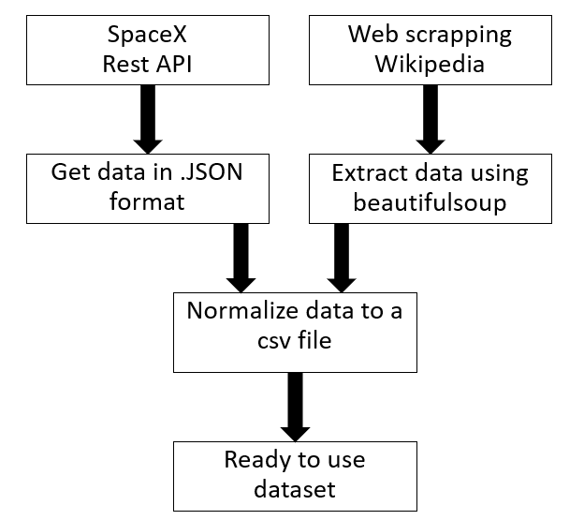
Data Collection
Request data from the SpaceX API was used, cleaned and formated. BeautifulSoup was used to web scrape Falcon 9 launch records from Wikipedia, extract the HTML table, and convert data into a Pandas DataFrame for analysis.
https://en.wikipedia.org/w/index.php?title=List_of_Falcon_9_and_Falcon_Heavy_launches&oldid=1027686922
https://api.spacexdata.com/v4/rockets/

Slide 8
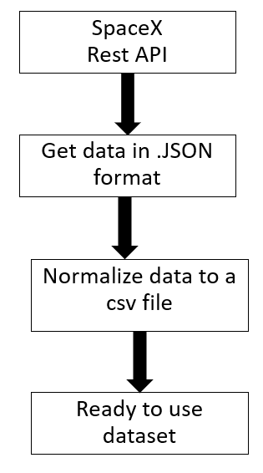
Data Collection – SpaceX API
Identify Data Requirements: Determine the specific SpaceX data needed (e.g., launches, rockets, missions).
Access SpaceX API Documentation: Review the available REST endpoints and their parameters from the SpaceX API documentation.
Make API Requests: Use the appropriate REST API endpoints to request the required data.
Parse and Store Data: Process the API response to extract and store the relevant information.
Add the GitHub URL of the completed SpaceX API calls notebook (must include completed code cell and outcome cell), as an external reference and peer-review purpose

Slide 9
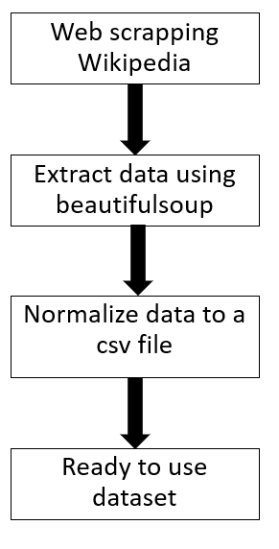
Data Collection - Scraping
Install Required Libraries: Ensure you have Beautiful Soup and a library for making HTTP requests installed (e.g., requests).
Fetch Web Page Content: Use an HTTP request to get the HTML content of the webpage.
Parse HTML Content: Use Beautiful Soup to parse the fetched HTML content.
Extract Desired Data: Use Beautiful Soup methods to locate and retrieve specific elements or data from the parsed HTML.
Notebooks can be found on GitHub:
Wikipedia: https://github.com/MMS194/Data-Science-Capstone-IBM-Course/blob/90e1a4ade22e56da7fca16520f0dae98ae0d5ba6/DataScienceCapstone/jupyter-labs-webscraping%20(2).ipynb
REST API: https://github.com/MMS194/Data-Science-Capstone-IBM-Course/blob/90e1a4ade22e56da7fca16520f0dae98ae0d5ba6/DataScienceCapstone/jupyter-labs-spacex-data-collection-api.ipynb

Slide 10
Data Wrangling
Data wrangling was performed by examining attributes such as Flight Number, Date, Booster Version, Payload Mass, Orbit, Launch Site, and Landing Outcome.
We explored launch sites like Vandenberg AFB and Kennedy Space Center, as well as orbits such as LEO and GTO. The "Outcome" column, which indicated the success or failure of the first-stage landing, was converted into a binary classification: 0 for failed landings and 1 for successful landings. This conversion allowed us to classify launch outcomes for further analysis.
Github: https://github.com/MMS194/Data-Science-Capstone-IBM-Course/blob/90e1a4ade22e56da7fca16520f0dae98ae0d5ba6/DataScienceCapstone/labs-jupyter-spacex-Data%20wrangling.ipynb

Slide 11
EDA with Data Visualization
Charts that were plotted:
Flight Number vs. Launch Site
Payload vs. Launch Site
Success Rate vs. Orbit Type
Flight Number vs. Orbit Type
Payload vs. Orbit Type
Launch Success Yearly Trend
Github: https://github.com/MMS194/Data-Science-Capstone-IBM-Course/blob/90e1a4ade22e56da7fca16520f0dae98ae0d5ba6/DataScienceCapstone/jupyter-labs-EDA-dataviz.ipynb.jupyterlite.ipynb

Slide 12
EDA with SQL
SQL queries performed:
All Launch Site Names
Launch Site Names Begin with 'CCA'
Total Payload Mass
Average Payload Mass by F9 v1.1
First Successful Ground Landing Date
Successful Drone Ship Landing with Payload between 4000 and 6000
Total Number of Successful and Failure Mission Outcomes
Boosters Carried Maximum Payload
2015 Launch Records
Rank Landing Outcomes Between 2010-06-04 and 2017-03-20
Github: https://github.com/MMS194/Data-Science-Capstone-IBM-Course/blob/90e1a4ade22e56da7fca16520f0dae98ae0d5ba6/DataScienceCapstone/jupyter-labs-eda-sql-coursera_sqllite.ipynb

Slide 13
Build an Interactive Maps with Folium
Plots/graphs and interactions that have been added to a dashboard:
All launch sites have been presented in a map
All launch records were shown with its result
Closest cities and highways are shown
Using folium to create interactive maps enables the possibility to overlay information on maps, revealing spatial patterns and insights. Knowing location enhances data analysis by linking trends to geographic regions, helping to uncover correlations, optimize resources, and make informed decisions based on where events or trends occur.
https://github.com/MMS194/Data-Science-Capstone-IBM-Course/blob/90e1a4ade22e56da7fca16520f0dae98ae0d5ba6/DataScienceCapstone/lab_jupyter_FOLIUM_launch_site_location.ipynb

Slide 14
Build a Dashboard with Plotly Dash
Plots/graphs and interactions that have been added to a dashboard:
All launch sites have been presented in a map
All launch records were shown with its result
Closest cities and highways are shown
GitHub: https://github.com/MMS194/Data-Science-Capstone-IBM-Course/blob/90e1a4ade22e56da7fca16520f0dae98ae0d5ba6/DataScienceCapstone/spacex_dash_app.py

Slide 15
Predictive Analysis (Classification)
Machine learning models were used to determine if the first stage of Falcon 9 will land successfully. Data was split into training data and test data to find the best Hyperparameter for SVM, Classification Trees, and Logistic Regression. Then the best performing was selected using test data.
Flow chart: Start → Divide Data into Training and Test Sets → Optimize Hyperparameters for Models → Evaluate Performance → Select Best-Performing Model → End
Add the GitHub URL of your completed predictive analysis lab, as an external reference and peer-review purpose

Slide 16
Results
In the exploratory data analysis (EDA) of SpaceX Falcon 9 landings, we examined various factors influencing landing success. We analyzed patterns in launch conditions, payload mass, orbit, and historical landing data. Key insights included identifying significant variables affecting landing outcomes and detecting trends over time. This analysis provided a foundational understanding of the factors contributing to successful landings and guided further modeling and optimization efforts.
Result of different machine learning algorithms:
Method | Score | Accuracy
logreg_cv | 0.944444 | 0.822222
svm_cv | 0.944444 | 0.822222
tree_cv | 0.833333 | 0.877778
knn_cv | 0.944444 | 0.84444

Slide 17

Section 2

Slide 18
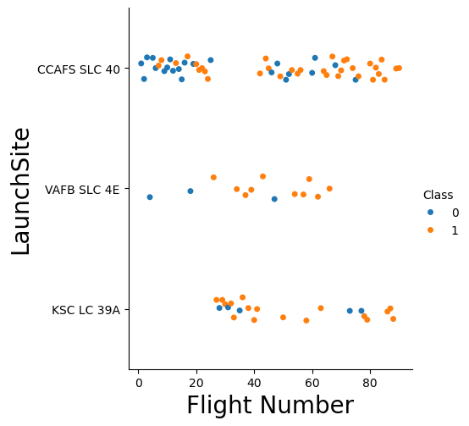
Flight Number vs. Launch Site

Slide 19
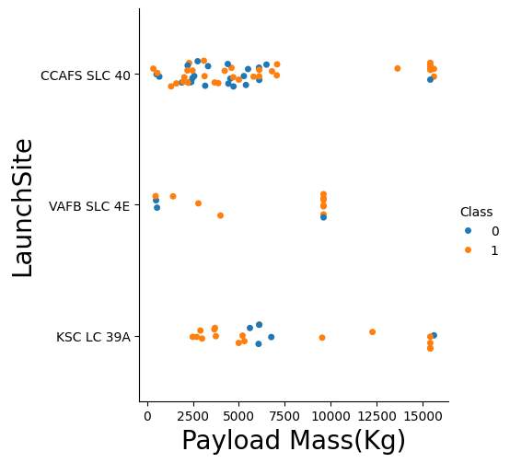
Payload vs. Launch Site
VAFB SLC 4E is only used when mass is lower than 10000kg,
Note that the big payload mass (>12500kg) is rare but usually successful

Slide 20
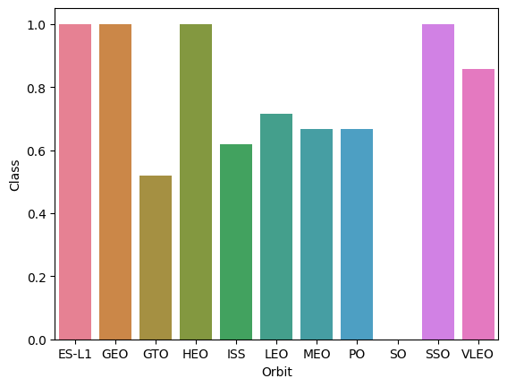
Success Rate vs. Orbit Type
Lowest succes rate belongs to GTO.
Best performing ES-L1, GEO, HEO and SSO

Slide 21
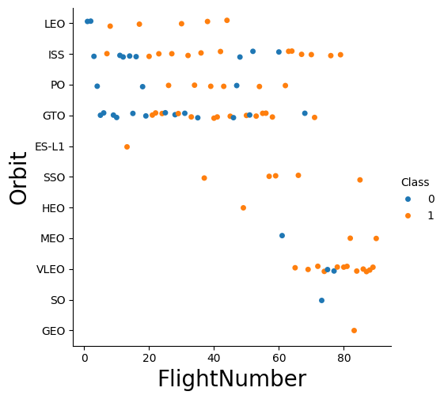
Flight Number vs. Orbit Type
Show a scatter point of Flight number vs. Orbit type
Show the screenshot of the scatter plot with explanations

Slide 22
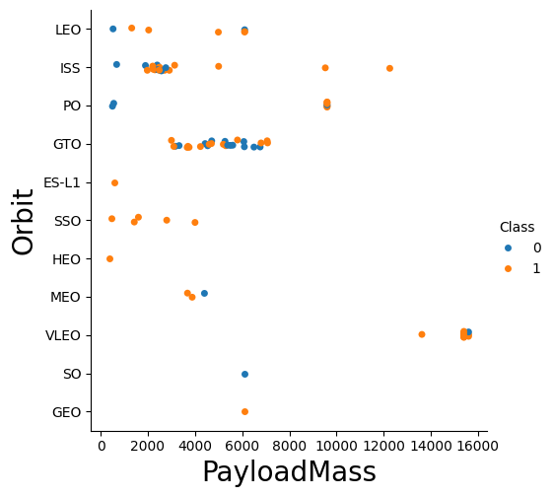
Payload vs. Orbit Type

Slide 23
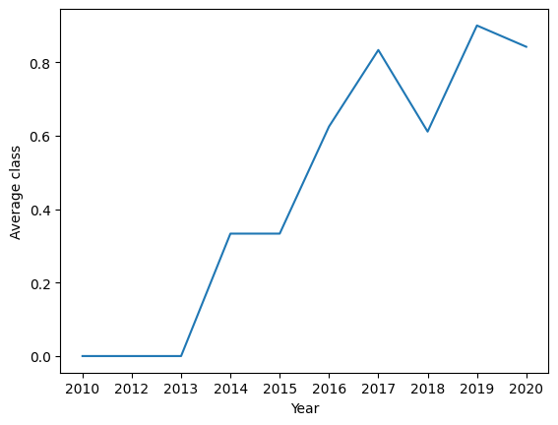
Launch Success Yearly Trend
Success rate since 2013 keeps increasing, meaning that there is a direct correlation between time and success rate.

Slide 24
All Launch Site Names
%sql SELECT DISTINCT Launch_Site FROM SPACEXTABLE
Launch_Site
CCAFS LC-40
VAFB SLC-4E
KSC LC-39A
CCAFS SLC-40

Slide 25
Launch Site Names Begin with 'CCA'
%sql SELECT DISTINCT Launch_Site FROM SPACEXTABLE WHERE SUBSTRING(Launch_Site, 1, 3) = 'CCA'
Present your query result with a short explanation here
Launch_Site
CCAFS LC-40
CCAFS SLC-40

Slide 26
Total Payload Mass
%sql SELECT SUM(PAYLOAD_MASS__KG_) FROM SPACEXTABLE
SUM(PAYLOAD_MASS__KG_)
619967

Slide 27
Average Payload Mass by F9 v1.1
%sql SELECT AVG(PAYLOAD_MASS__KG_) FROM SPACEXTABLE
AVG(PAYLOAD_MASS__KG_)
6138.287128712871

Slide 28
First Successful Ground Landing Date
%sql SELECT MIN(Date) FROM SPACEXTABLE
MIN(Date)
2010-06-04

Slide 29
Successful Drone Ship Landing with Payload between 4000 and 6000
%sql SELECT Booster_Version FROM SPACEXTABLE WHERE (PAYLOAD_MASS__KG_ > 4000 AND PAYLOAD_MASS__KG_ < 6000 AND Landing_Outcome = 'Success (drone ship)')
Booster_Version
F9 FT B1022
F9 FT B1026
F9 FT B1021.2
F9 FT B1031.2

Slide 30
Total Number of Successful and Failure Mission Outcomes
%sql SELECT COUNT(*) FROM SPACEXTABLE WHERE SUBSTRING(Landing_Outcome, 1, 7) = 'Success'
COUNT(*)
61

Slide 31
Boosters Carried Maximum Payload
%sql SELECT booster_version FROM SPACEXTABLE WHERE PAYLOAD_MASS__KG_ = (SELECT MAX(PAYLOAD_MASS__KG_)FROM SPACEXTABLE)
Booster_Version
F9 B5 B1048.4
F9 B5 B1049.4
F9 B5 B1051.3
F9 B5 B1056.4
F9 B5 B1048.5
F9 B5 B1051.4
F9 B5 B1049.5
F9 B5 B1060.2
F9 B5 B1058.3
F9 B5 B1051.6
F9 B5 B1060.3
F9 B5 B1049.7

Slide 32
2015 Launch Records
%sql select * from SPACEXTABLE where Landing_Outcome not like 'Success%' and (DATE between '2015-01-01' and '2015-12-31') order by date desc
Date | Time (UTC) | Booster_Version | Launch_Site | Payload | PAYLOAD_MASS__KG_ | Orbit | Customer | Mission_Outcome | Landing_Outcome
2015-06-28 | 14:21:00 | F9 v1.1 B1018 | CCAFS LC-40 | SpaceX CRS-7 | 1952 | LEO (ISS) | NASA (CRS) | Failure (in flight) | Precluded (drone ship)
2015-04-27 | 23:03:00 | F9 v1.1 B1016 | CCAFS LC-40 | Turkmen 52 / MonacoSAT | 4707 | GTO | Turkmenistan National Space Agency | Success | No attempt
2015-04-14 | 20:10:00 | F9 v1.1 B1015 | CCAFS LC-40 | SpaceX CRS-6 | 1898 | LEO (ISS) | NASA (CRS) | Success | Failure (drone ship)
2015-03-02 | 3:50:00 | F9 v1.1 B1014 | CCAFS LC-40 | ABS-3A Eutelsat 115 West B | 4159 | GTO | ABS Eutelsat | Success | No attempt
2015-02-11 | 23:03:00 | F9 v1.1 B1013 | CCAFS LC-40 | DSCOVR | 570 | HEO | U.S. Air Force NASA NOAA | Success | Controlled (ocean)
2015-01-10 | 9:47:00 | F9 v1.1 B1012 | CCAFS LC-40 | SpaceX CRS-5 | 2395 | LEO (ISS) | NASA (CRS) | Success | Failure (drone ship)

Slide 33
Rank Landing Outcomes Between 2010-06-04 and 2017-03-20
%sql SELECT Landing_Outcome, COUNT(*) AS Count FROM SPACEXTABLE WHERE Date BETWEEN '2010-06-04' AND '2017-03-20' GROUP BY Landing_Outcome ORDER BY Count DESC;
Landing_Outcome | Count
No attempt | 10
Success (drone ship) | 5
Failure (drone ship) | 5
Success (ground pad) | 3
Controlled (ocean) | 3
Uncontrolled (ocean) | 2
Failure (parachute) | 2
Precluded (drone ship) | 1

Slide 34

Section 3

Slide 35
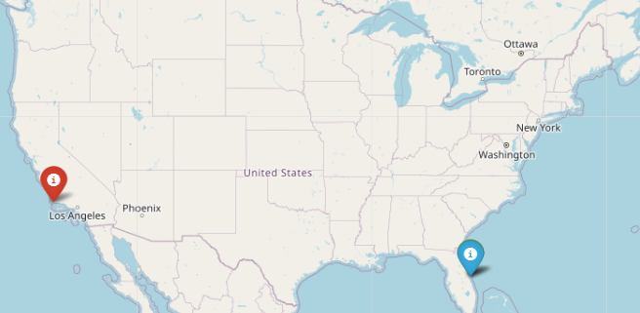
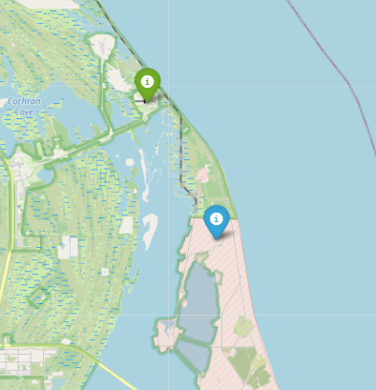
Launch sites on a map
Launch Site | Lat | Long | Color
CCAFS LC-40 | 28.562302 | -80.577356 | Blue
CCAFS SLC-40 | 28.563197 | -80.576820 | Green
KSC LC-39A | 28.573255 | -80.646895 | Green
VAFB SLC-4E | 34.632834 | -120.610745 | Red

Slide 36
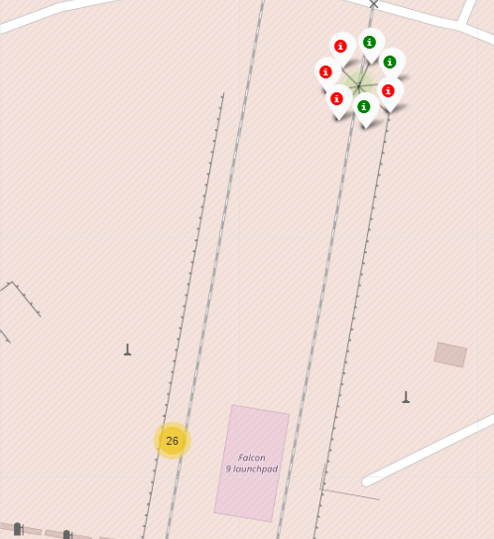
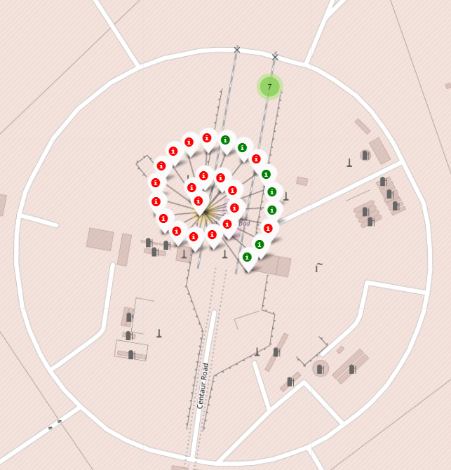
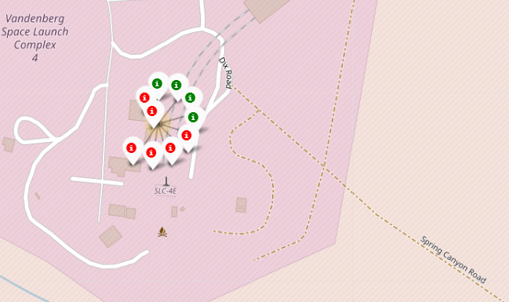
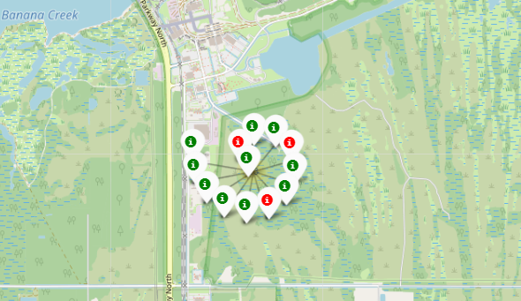
All launch records
If a launch was successful `(class=1)`, then we use a green marker and if a launch was failed, we use a red marker `(class=0)`.
Highest success rate at KSC LC-39A (76.92%).
Lowest success rate at CCAFS LC-40 (26.92%).

Slide 37
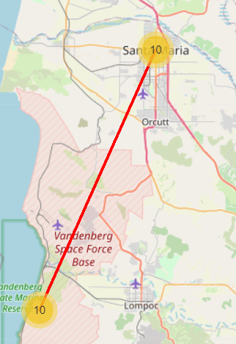
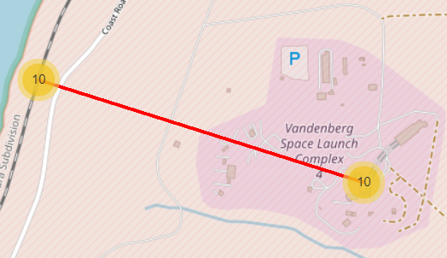
Closest city and highway to VAFB SLC-4E

Slide 38

Section 4

Slide 39
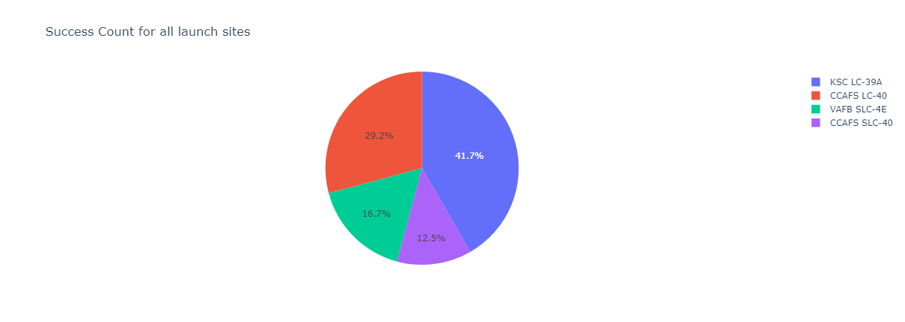
Success counts for all launch sites

Slide 40
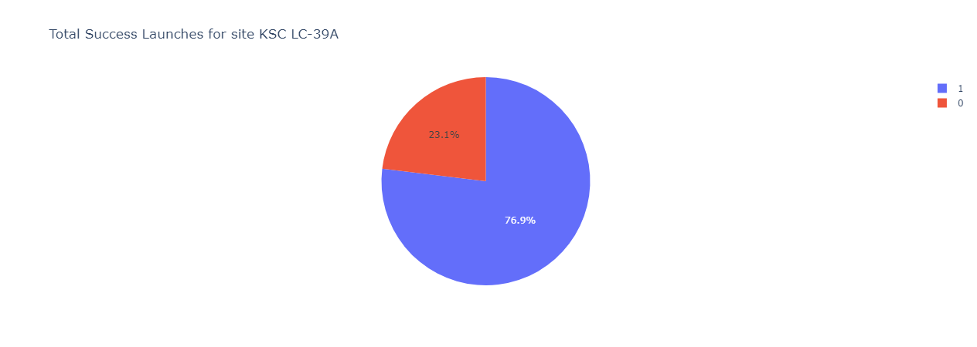
Launch site with highest launch success ratio

Slide 41
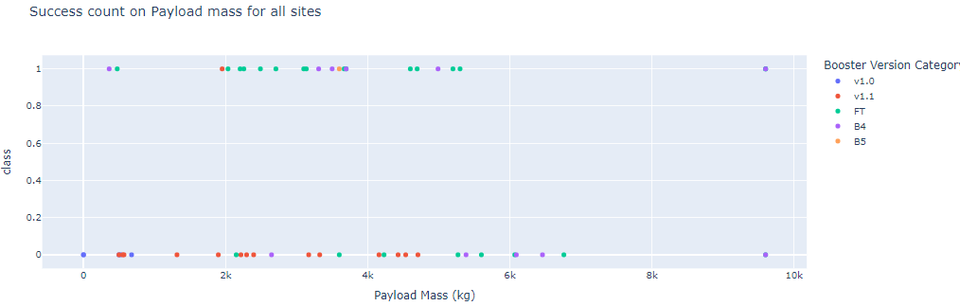
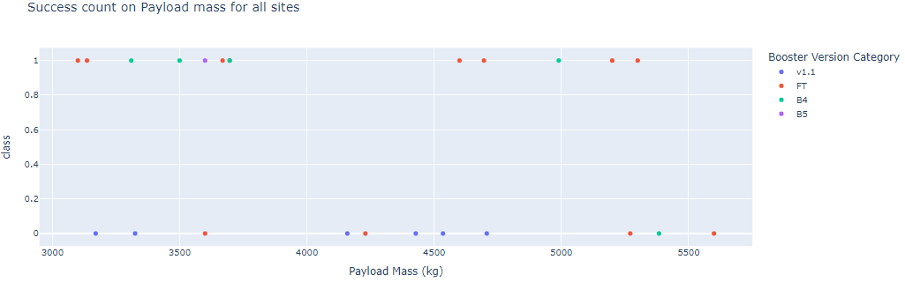
Payload vs. Launch Outcome scatter plot for all sites, with different payload
All range:
From 3000kg to 6000kg:

Slide 42

Section 5

Slide 43
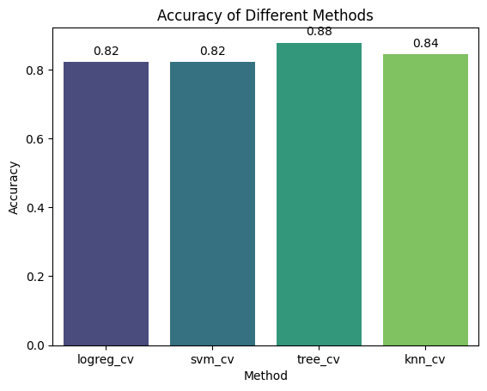
Classification Accuracy
Method | Score | Accuracy
logreg_cv | 0.944444 | 0.822222
svm_cv | 0.944444 | 0.822222
tree_cv | 0.833333 | 0.877778
knn_cv | 0.944444 | 0.84444
The model that has the highest classification accuracy is the classification tree

Slide 44

Confusion Matrix for best performing model (KNN)
This confusion matrix shows a KNN model's performance with four metrics: True Positive (TP), True Negative (TN), False Positive (FP), and False Negative (FN). TP and TN indicate correct classifications, while FP and FN represent misclassifications. This matrix helps compute key metrics like accuracy, precision, recall, and F1-score to evaluate how well the model distinguishes between classes. We can clearly see that it is very accurate since it only detects one TN and has No FP

Slide 45
Conclusions
Launch Site Trends: Certain launch sites are more frequently used and may influence landing success based on geographic or technical factors.
Payload Impact: Payload size and type show varying effects on landing success, suggesting that different payloads could affect mission outcomes.
Orbit Type Correlations: Success rates differ across orbit types, indicating that specific orbits might present more challenges or opportunities for successful landings.
Yearly Trends: There is a noticeable trend in launch success rates over the years, highlighting improvements or changes in technology and processes.
Highest Accuracy: tree_cv has the highest accuracy (0.877778), outperforming logreg_cv and svm_cv (both 0.822222) and knn_cv (0.84444).
Score Consistency: logreg_cv, svm_cv, and knn_cv share the same score (0.944444), but their accuracies differ, indicating varying prediction effectiveness.
Accuracy vs. Score Trade-off: Despite having the lowest score (0.833333), tree_cv achieves the highest accuracy, suggesting it may be better at making accurate predictions even with a lower score.

Slide 46
Appendix
Data collection:
Wikipedia: https://github.com/MMS194/Data-Science-Capstone-IBM-Course/blob/90e1a4ade22e56da7fca16520f0dae98ae0d5ba6/DataScienceCapstone/jupyter-labs-webscraping%20(2).ipynb
REST API: https://github.com/MMS194/Data-Science-Capstone-IBM-Course/blob/90e1a4ade22e56da7fca16520f0dae98ae0d5ba6/DataScienceCapstone/jupyter-labs-spacex-data-collection-api.ipynb
Data wrangling: https://github.com/MMS194/Data-Science-Capstone-IBM-Course/blob/90e1a4ade22e56da7fca16520f0dae98ae0d5ba6/DataScienceCapstone/labs-jupyter-spacex-Data%20wrangling.ipynb
EDA with data visualization: https://github.com/MMS194/Data-Science-Capstone-IBM-Course/blob/90e1a4ade22e56da7fca16520f0dae98ae0d5ba6/DataScienceCapstone/jupyter-labs-EDA-dataviz.ipynb.jupyterlite.ipynb
EDA with SQL: https://github.com/MMS194/Data-Science-Capstone-IBM-Course/blob/90e1a4ade22e56da7fca16520f0dae98ae0d5ba6/DataScienceCapstone/jupyter-labs-eda-sql-coursera_sqllite.ipynb
Interactive maps with folium: https://github.com/MMS194/Data-Science-Capstone-IBM-Course/blob/90e1a4ade22e56da7fca16520f0dae98ae0d5ba6/DataScienceCapstone/lab_jupyter_FOLIUM_launch_site_location.ipynb
Dashboard with plotly dash: https://github.com/MMS194/Data-Science-Capstone-IBM-Course/blob/90e1a4ade22e56da7fca16520f0dae98ae0d5ba6/DataScienceCapstone/spacex_dash_app.py

Slide 47


